Slide 1
Turing Machines (TMs)
head
a
b
a
b
b
˽
˽
. . .
Finite control
read/write input tape
Head can read and write
Head is two way (can move left or right)
Tape is infinite (to the right)
Infinitely many blanks “˽“ follow input
Can accept or reject any time (not only at end of input)

Slide 2

TM – example
TM recognizing $B=\left\{{\text{a}}^{k}{\text{b}}^{k} | k≥0\right\}$
Scan right until ˽ while checking if input is in ${\text{a}}^{∗}{\text{b}}^{∗}$, reject if not.
Scan left, crossing off single b and a
If the last one of each symbol, accept.
If the last one of some symbol but not others, reject.
Scan right, crossing off single a and b.
If the last one of each symbol, accept.
If the last one of some symbol but not others, reject.
If both symbols remain, repeat from (2).
head
input tape
Finite control
a
a
a
b
b
b
˽
˽
˽

Slide 3


TM – Formal Definition
Defn: A Turing Machine (TM) is a 7-tuple $(Q, Σ, Γ, δ,q_{0}, q\text{acc} , q\text{rej})$
$Σ$ input alphabet
$Γ$ tape alphabet ($Σ⊆Γ$)
$δ: Q×Γ→Q×Γ×$ {L, R} (L = Left, R = Right)
$δ\left(q,\text{a}\right)=(r,\text{b},$ R$)$
On input $w$ a TM $M$ may halt (enter $q\text{acc}$ or $q\text{rej}$) or $M$ may run forever (“loop”).
So $M$ has 3 possible outcomes for each input $w$:
Accept $w$ (enter $q\text{acc}$)
Reject $w$by halting (enter $q\text{rej}$ )
Reject $w$by looping (running forever)

Slide 5
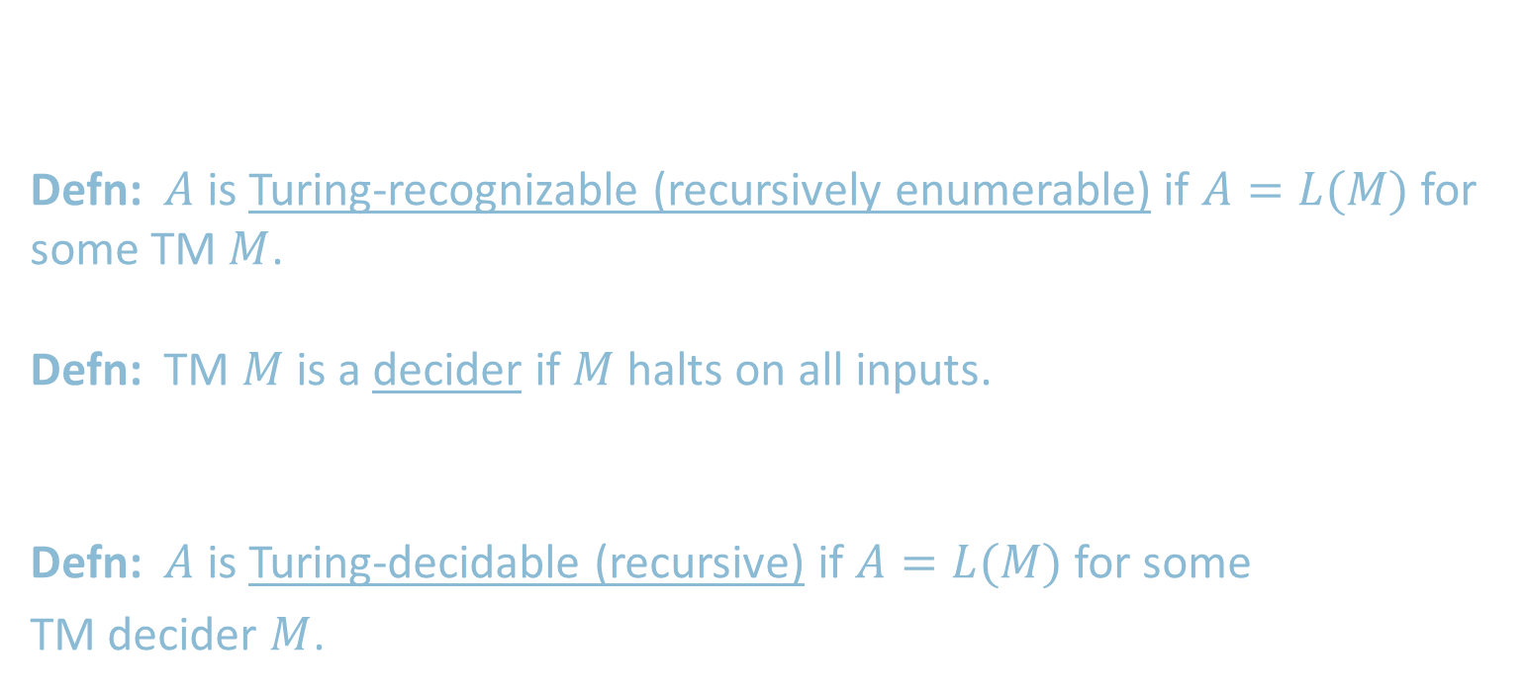
TM Recognizers and Deciders
Let $M$ be a TM. Then $L\left(M\right)=\left\{w\right| M$ accepts $w\}$.
Say that $M$ recognizes $A$ if $A=L(M)$.
Defn: $A$ is Turing-recognizable (recursively enumerable) if $A=L(M)$ for some TM $M$.
Defn: TM $M$ is a decider if $M$ halts on all inputs.
Say that $M$ decides $A$ if $A=L(M)$ and $M$ is a decider.
Defn: $A$ is Turing-decidable (recursive) if $A=L(M)$ for some
TM decider $M$.
T-recognizable
T-decidable
CFLs
regular

